Slide 1


ANALYTICAL SKILLS: Participatory Action Research
Najmah, SKM, MPH, PhD
najmah.usman.7
najmah@fkm.unsri.ac.id

Slide 2
Find one picture to share your curiosity
1 Minutes

Slide 3
MAPPING YOUR IDEA
Write your curiosity
Write aim of your curiosity
Plan your research methodology
Timeline
Problem solving
10 Minutes

Slide 4
THEORY

Slide 5
4 key analytical skills
Critical thinking
Data and information analysis
Research
Problem solving

Slide 6
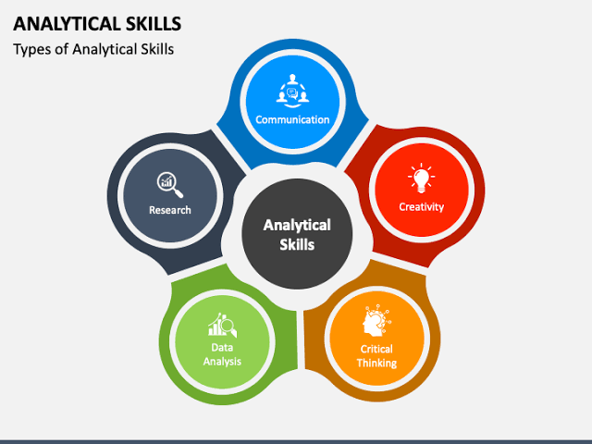
5 key analytical skills

Slide 7
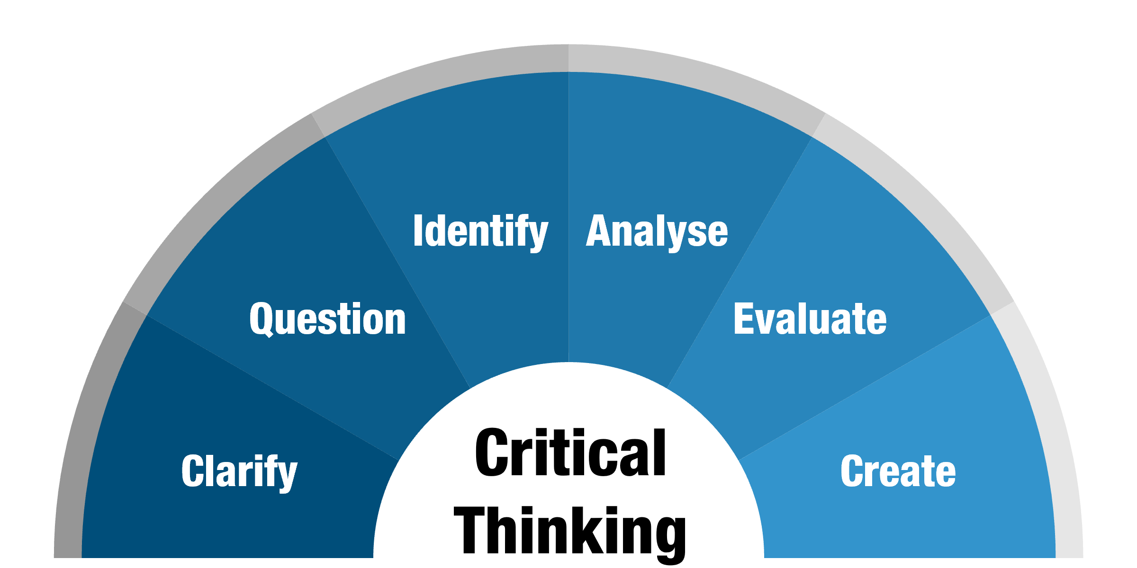
Critical Thinking
clarify your thinking purpose and context
question your sources of information
identify arguments
analyse sources and arguments
evaluate the arguments of others and
create or synthesise your own arguments.
https://www.monash.edu/student-academic-success/enhance-your-thinking/critical-thinking/what-is-critical-thinking

Slide 8
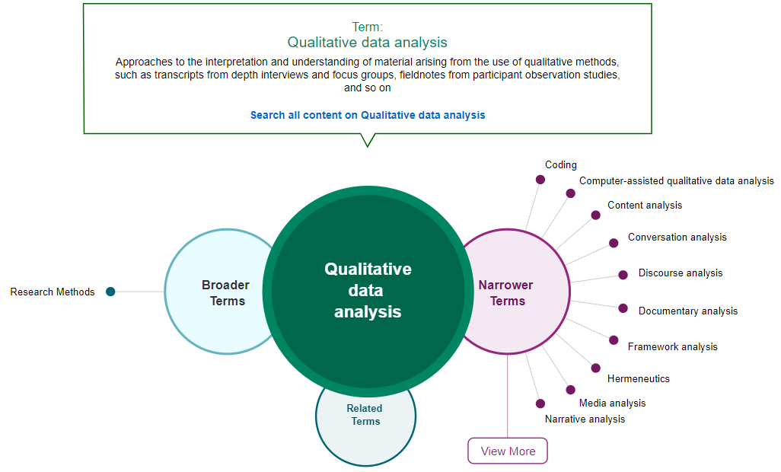
Data and information analysis
https://methods.sagepub.com/methods-map/qualitative-data-analysis

Slide 9
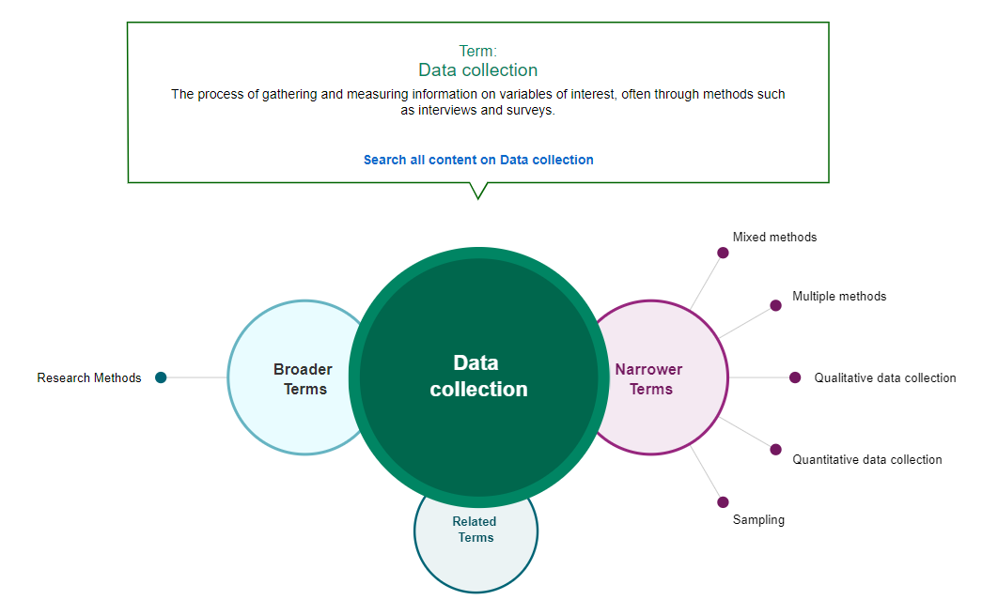
https://methods.sagepub.com/methods-map/quantitative-data-collection

Slide 10
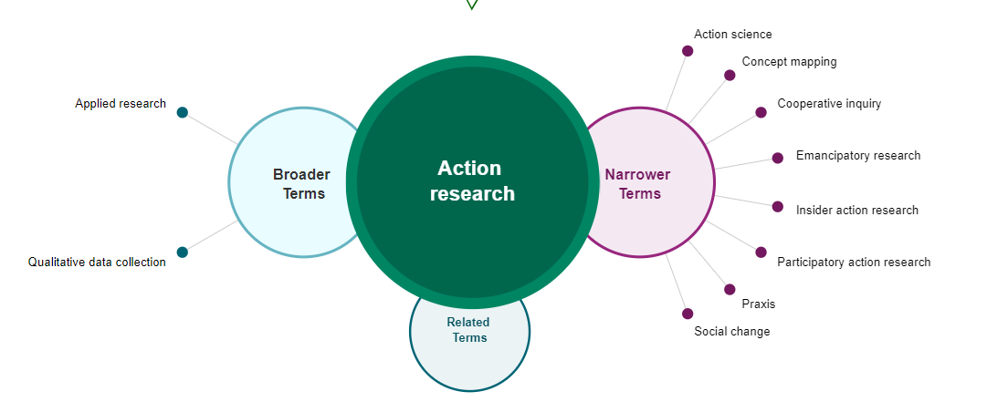
Research
Action Research:
A type of applied research designed to find the most effective way to bring about a desired social change or to solve a practical problem, usually in collaboration with those being researched
https://methods.sagepub.com/methods-map/quantitative-data-collection

Slide 11
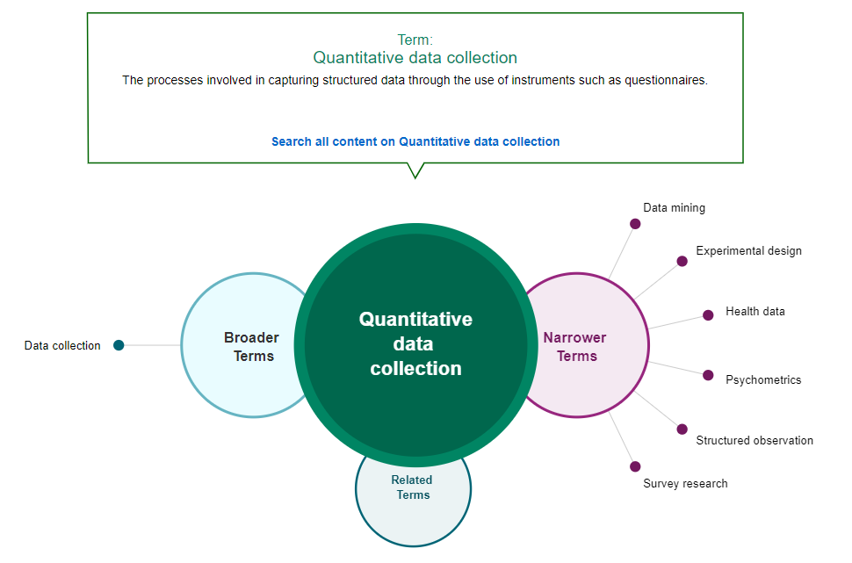
https://methods.sagepub.com/methods-map/quantitative-data-collection

Slide 12
Participatory Action Research

Slide 13
Photovoice?
Jenis penelitian Tindakan partisipatif dimana orang-biasanya mereka yang memiliki sedikit kekuatan menggunakan foto dan/atau video untuk menggambarkan lingkungan dan pengalaman mereka dan untuk mengekspresikan pemikiran mereka tentang berbagai hal.

Slide 14
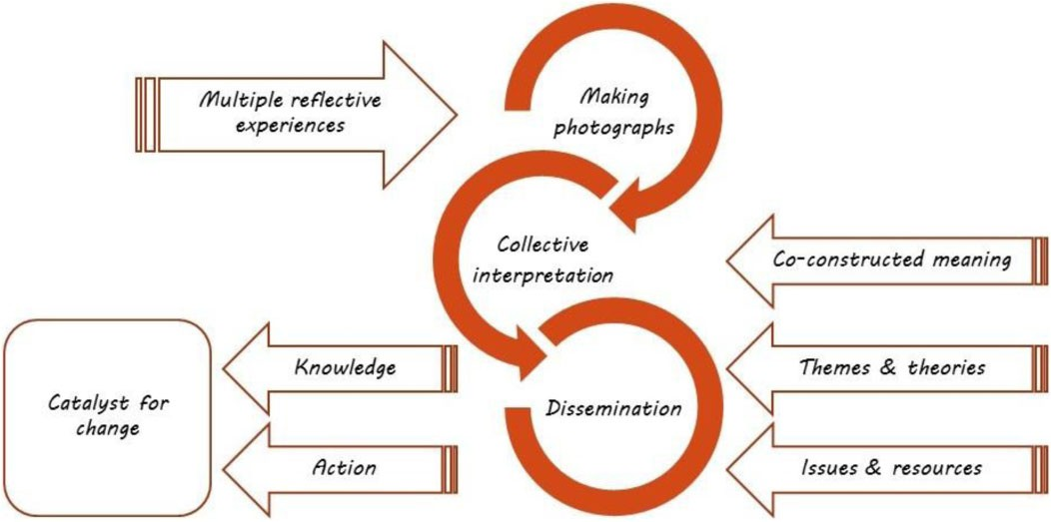
Implementasi Metode Photovoice

Slide 15

Problem solving

Slide 16
PRACTICE

Slide 17
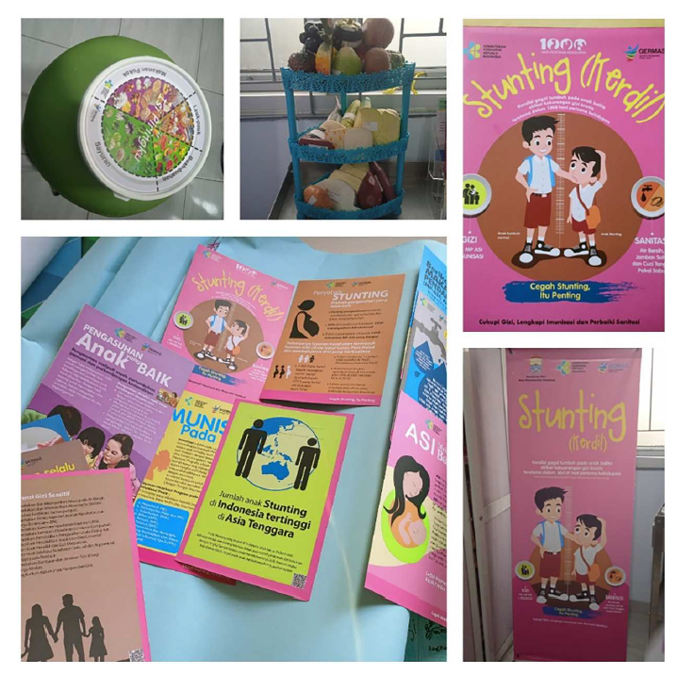
Participatory Action Research
Study case 1:
Saya melihat banyak media stunting di Kota Palembang dan kabupaten lainnya, tergantung dari media Kementrian Kesehatan dan sangat terbatas puskesmas dan dinas kesehatan untuk mengembangkan media promosi kesehatan berdasarkan kearifan lokal dan memberdayakan kader posyandu

Slide 18
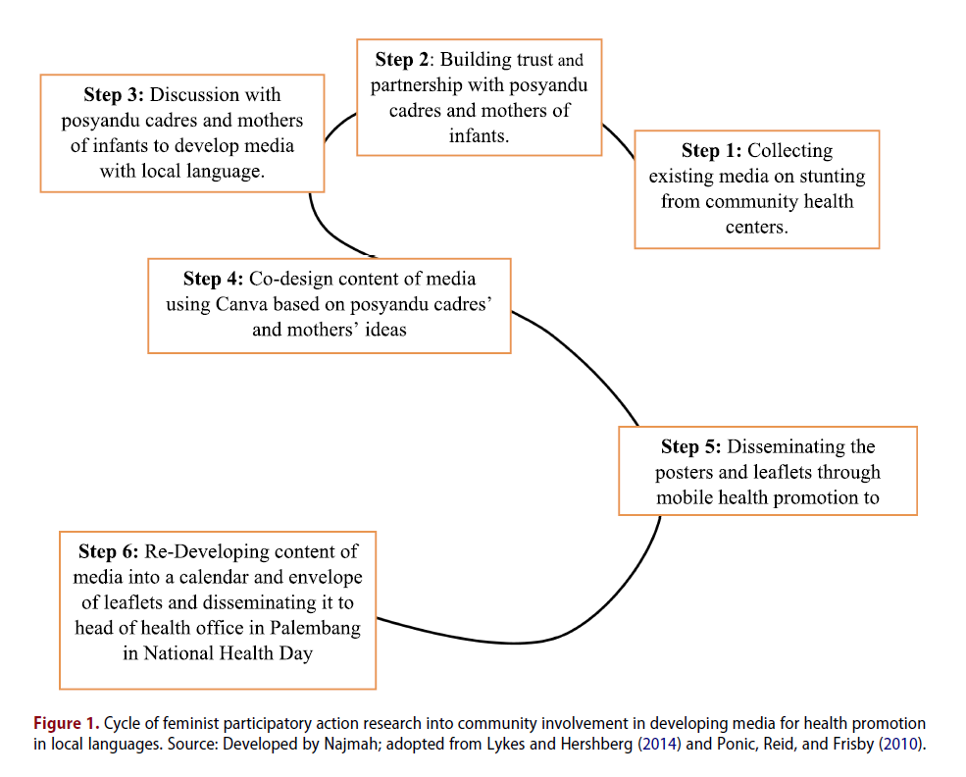
S Cycle

Slide 19
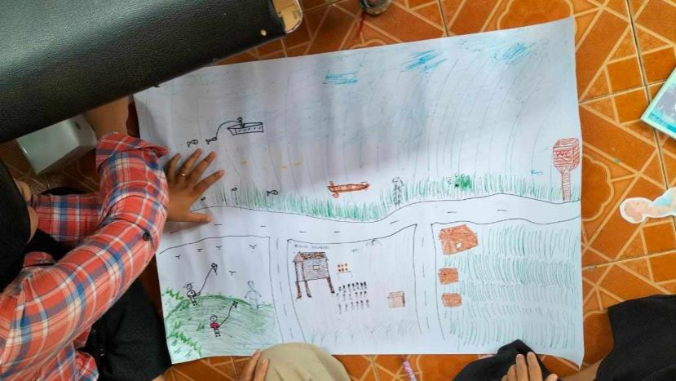
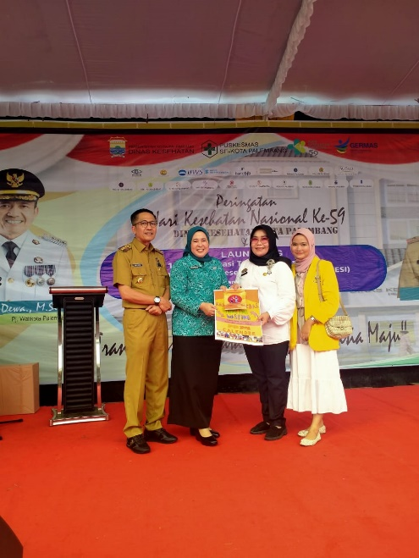
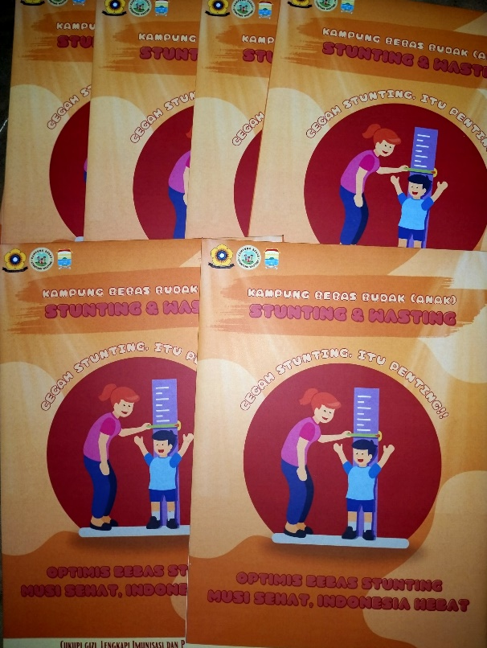
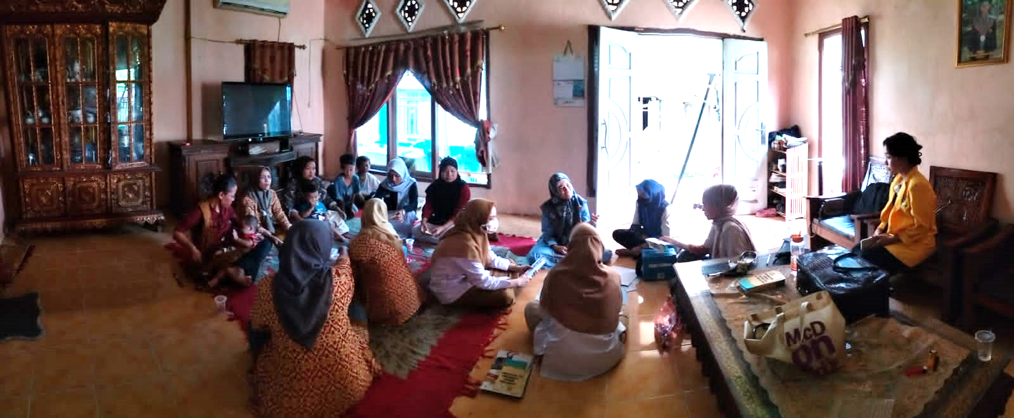

Slide 20
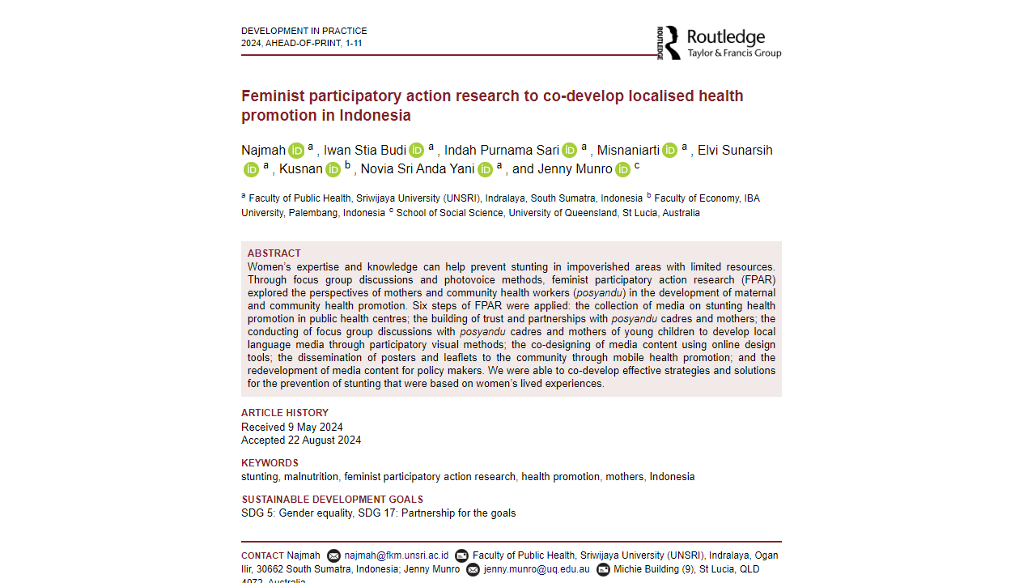
https://www.tandfonline.com/doi/full/10.1080/09614524.2024.2397500

Slide 21
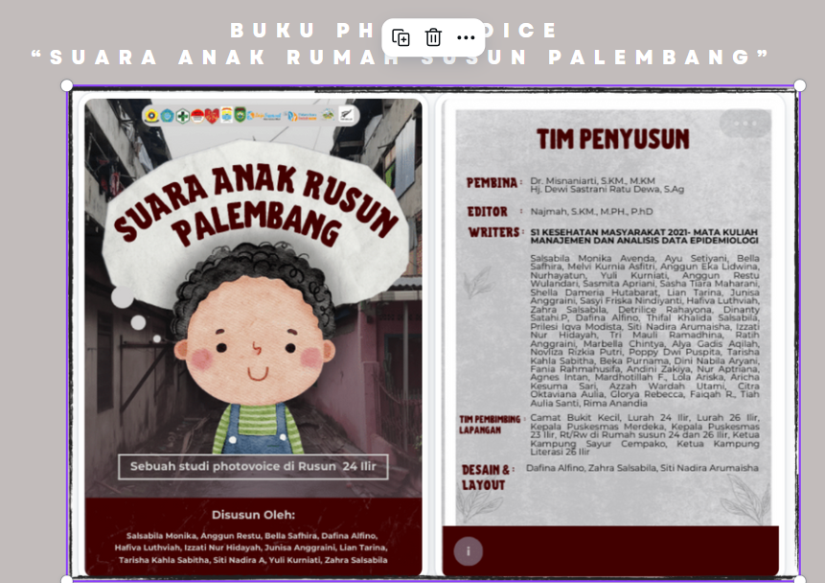
Photovoice
Study case 2:
Kami melihat fenomena rumah susun: suara anak rumah susun

Slide 22
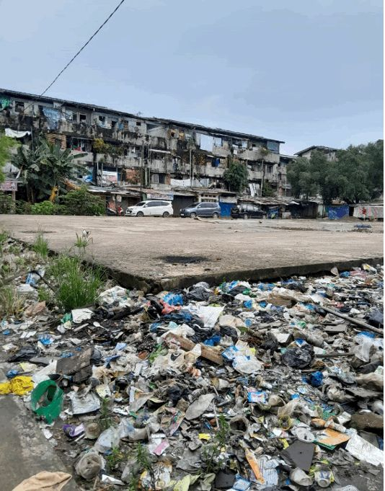
Di sini kak tempat aku galak maen dengan kawan, bagus ini lapangannyo bersih walaupun galak bau karno banyak sampah dipinggirnyo. Bagus be aku foto karno ado mobilnyo” – H, 8 Tahun, salah satu anak di rumah susun 24 ilir.
https://www.intensnews.id/merawat-harapan-suara-anak-dan-remaja-yang-bermukim-pada-slum-area-di-rumah-susun-24-ilir/

Slide 23
Photovoice
Study case 3:
Suara anak bantaran sungai musi: studi photovoice pada kegiatan : Sanitary Camp, Kampung Pandai 13 Ulu, Palembang

Slide 24
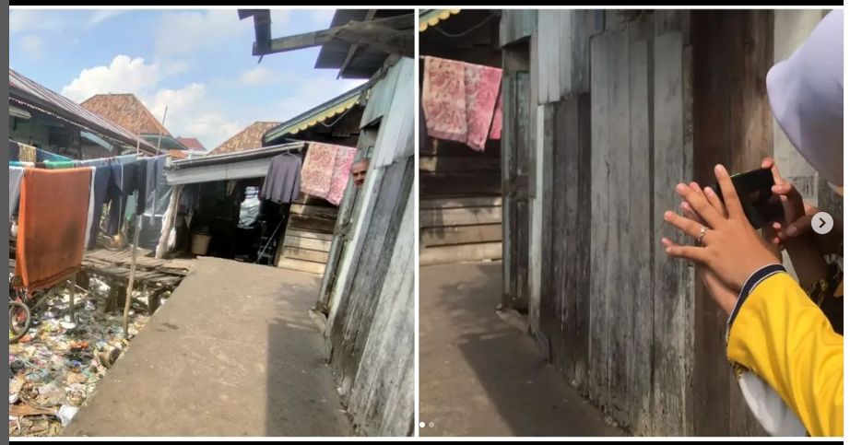
Kalo Kata Alim "Banyak sampah nyo kak, terus cak Idak bae ibu-ibu tu jemur baju yang di bawah nyo banyak sampah"

Slide 25
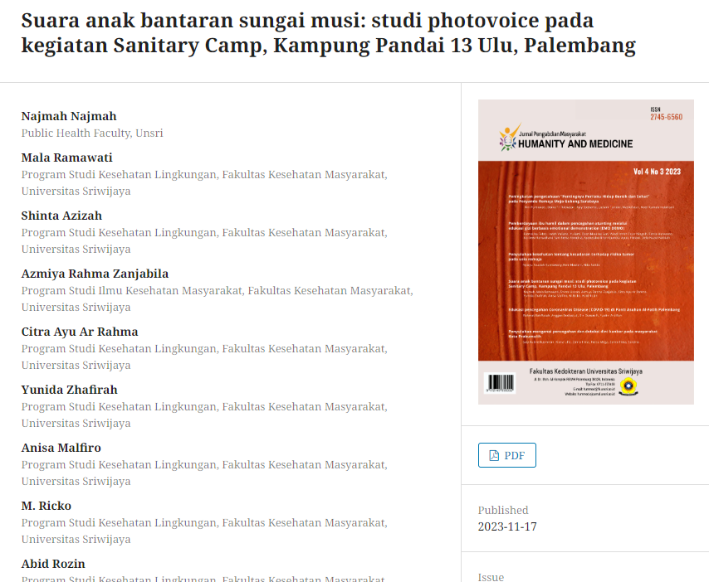
https://hummed2.ejournal.unsri.ac.id/index.php/HummedJ/article/view/116

Slide 26
MEDIA ANALYSIS
Study case 4:
Healthcare Worker Vulnerability and COVID-19
Panic, Tension and Distrust Through the Perspective of Social Media in Indonesia

Slide 27



Slide 28
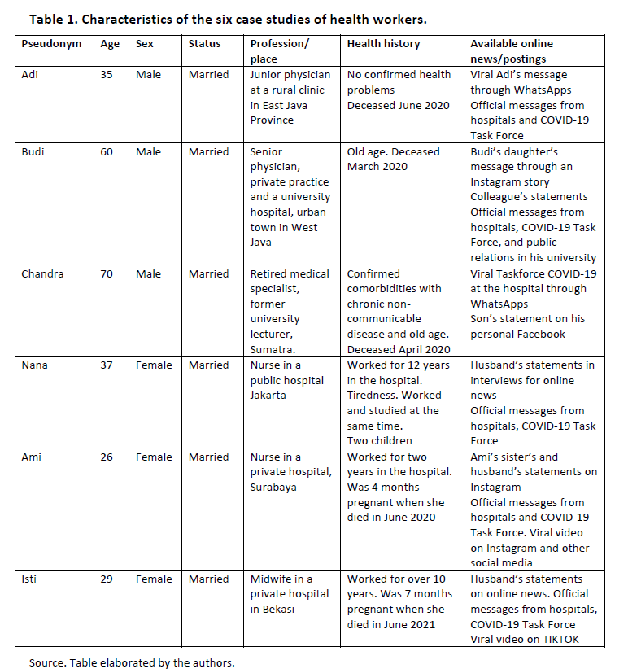
Theme 1. Media portrayal of social distrust against healthcare workers: Adi’s viral message
Theme 2. Stigmatisation versus denial: Budi’s and Chandra’s cases
Theme 3. Media portrayal of a hero for female healthcare workers
Thematic Analysis

Slide 29
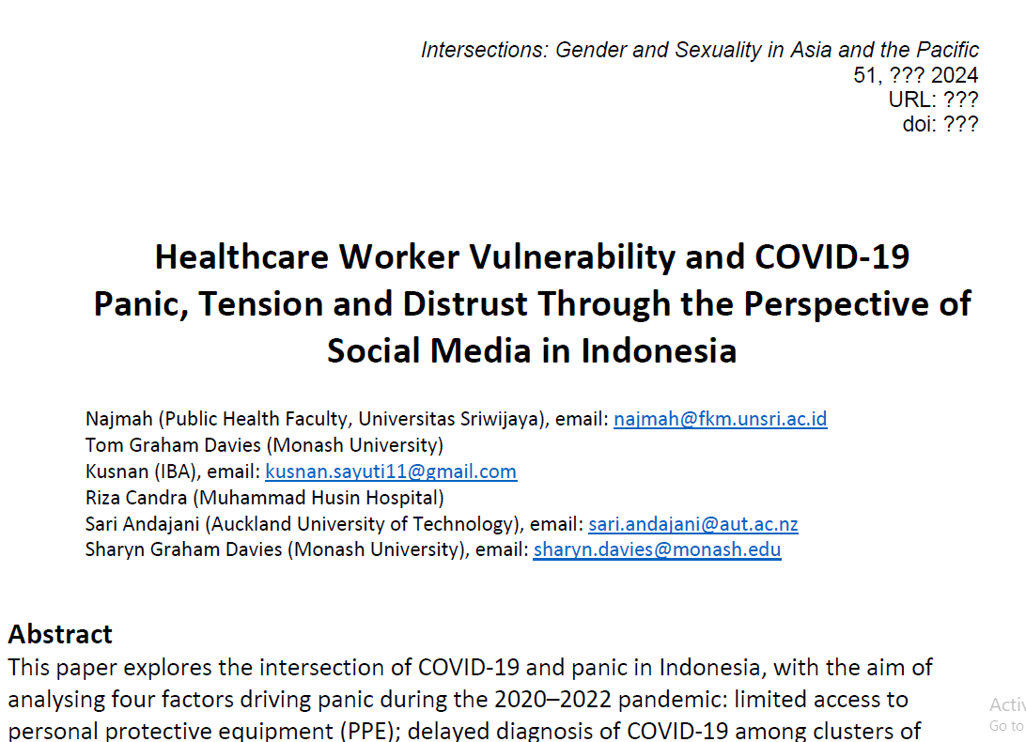

Slide 30


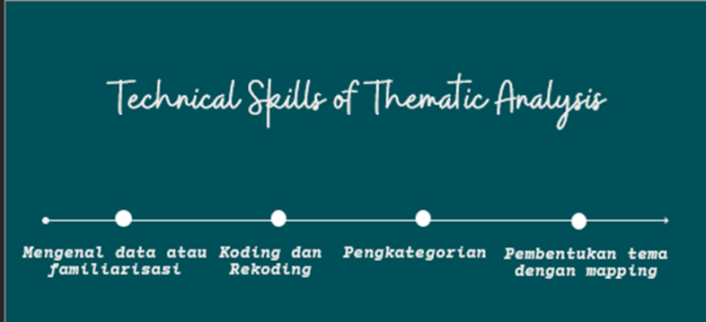
Langkah-Langkah

Slide 31
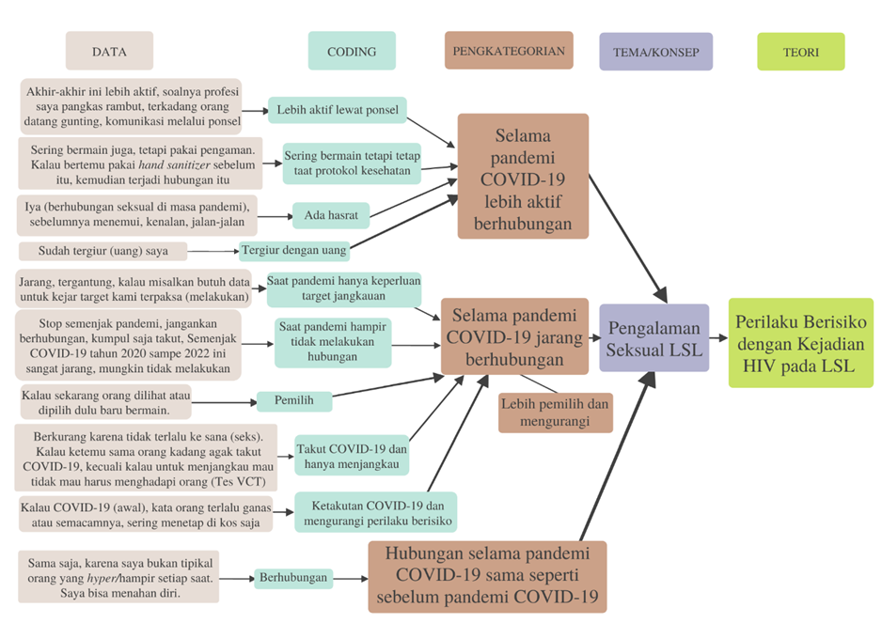
Mapping Sub-Tema saat Pandemi COVID-19
(Sumber: Data Primer Wawancara Mendalam Informan Utama LSL tahun 2022)

Slide 32
PRESENT YOUR ANALYTICAL SKIILS
Write your curiosity
Write aim of your curiosity
Plan your research methodology
Timeline
Problem solving
3 MINUTES Minutes in one slides

Slide 33
DISCUSSION TIME

